Slide 1
My Journey over 4 Continents to find the Best Prostate Cancer Cure
Alan Lawrenson

Slide 2
Talk Contents
My History and Diagnosis
The Cancer Anxiety Factor
Treatment Choices
My Treatment in Korea
What I Discovered after Korea
An ABC of Prostate Cancer in 2015

Slide 3
My History & Diagnosis
Father Died With Prostate Cancer aged 95
Brother Diagnosed in 2000 then aged 60
    PSA 7.5; Gleason 9 (High Risk Category); Type 1c
    High Dose Brachytherapy + X-Ray Radiation (6 weeks)
    Recurrence 2 years ago – Now on Hormone Therapy

Slide 4
My History & Diagnosis
I had 6 Monthly PSA test for 10 Years
PSA 3, then PSA 4, then PSA 5, finally PSA 7.5
At PSA 5 had 24 Core Biopsy
9 of the 24 cores were Cancerous
Type 1c: Gleason 7 (3+4)
Bone Scan + CT Scan = Clear

Slide 5
The Cancer Anxiety Factor
“Alan – You have Prostate Cancer”
  Your mind goes blank
  Awful thoughts cloud your judgement
  You are very vulnerable to the doctor’s advice
  Remember that PCa is a slow progression disease
  You generally have plenty of time to research options
  Fight the feeling that you must rid yourself immediately of the disease

Slide 6
Choices – 1st Urologist
He said “Let me do a Prostatectomy”
  I said “No”, but would consider other options over next 6 weeks whilst overseas on holiday
I focused on three options:
  HIFU (High Intensity Focused Ultrasound)
    Available in Sydney
  Hyperthermia
    Only done in Germany
  Proton Beam Therapy
    A Choice of 15 Centres worldwide

Slide 7
Enter the 2nd Urologist
One of 6 Sydney urologists doing HIFU
Recommended HDR Brachy + Radiation

Slide 8
Enter the 3rd Urologist
Checked my Flow Rates and Pressure
Both Sub-optimal
Did a TURP operation by burning away part of prostate
Significantly Improved Flow Rates
Also recommended HDR Brachy + Radiation
Arranged appointment with Radiation Oncologist in Sydney

Slide 9
What Did The Radiation Oncologist Say?
He would do HDR Brachy (needles) + 6 Weeks IMRT – Cost $33000 ($13000 out of my pocket)
Treatment in 3 months after TURP recovery
He strongly recommended I did not do PBT

Slide 10
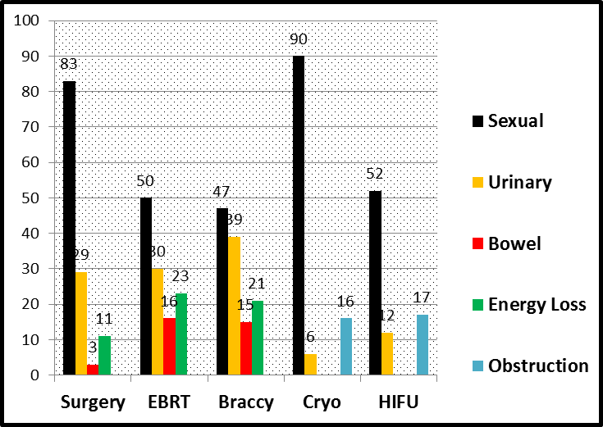
Side Effects of Treatment
% of Patients Treated
Data from LaZure Scientific Inc.

Slide 11
Decision Time
What was Out
Why
HDR Brachytherapy
Hyperthermia
Prostatectomy
HIFU
X-Ray Radiation
High Urinary Damage
TURP Scar Tissue
23% Have Recurrence
Was then out of Favour
Rectal Burning +++

Slide 12
Its Proton Beam in Korea
Minuses
  Very Expensive
  Have to go Overseas
  No Medicare Assistance
  No Health Insurance
Pluses
  Least Damage
  No Infection Risk
  $40,000 Less than USA
  Treatment + Holiday

Slide 13
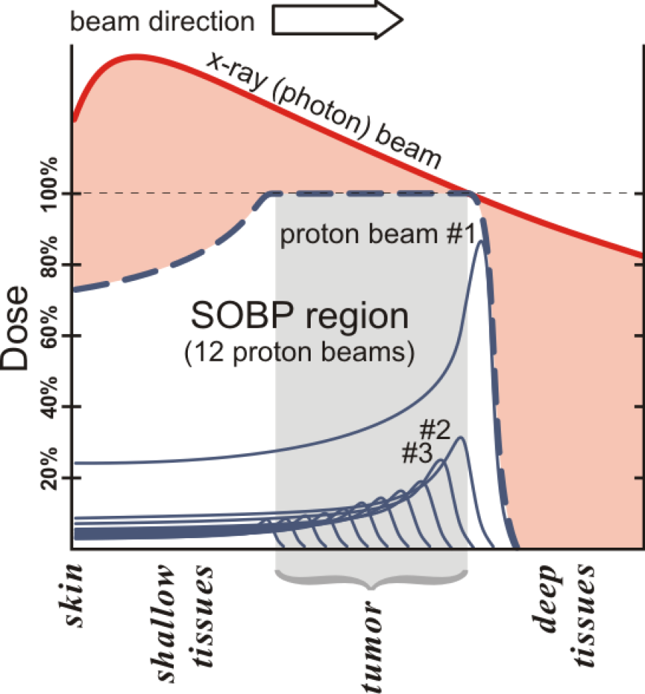
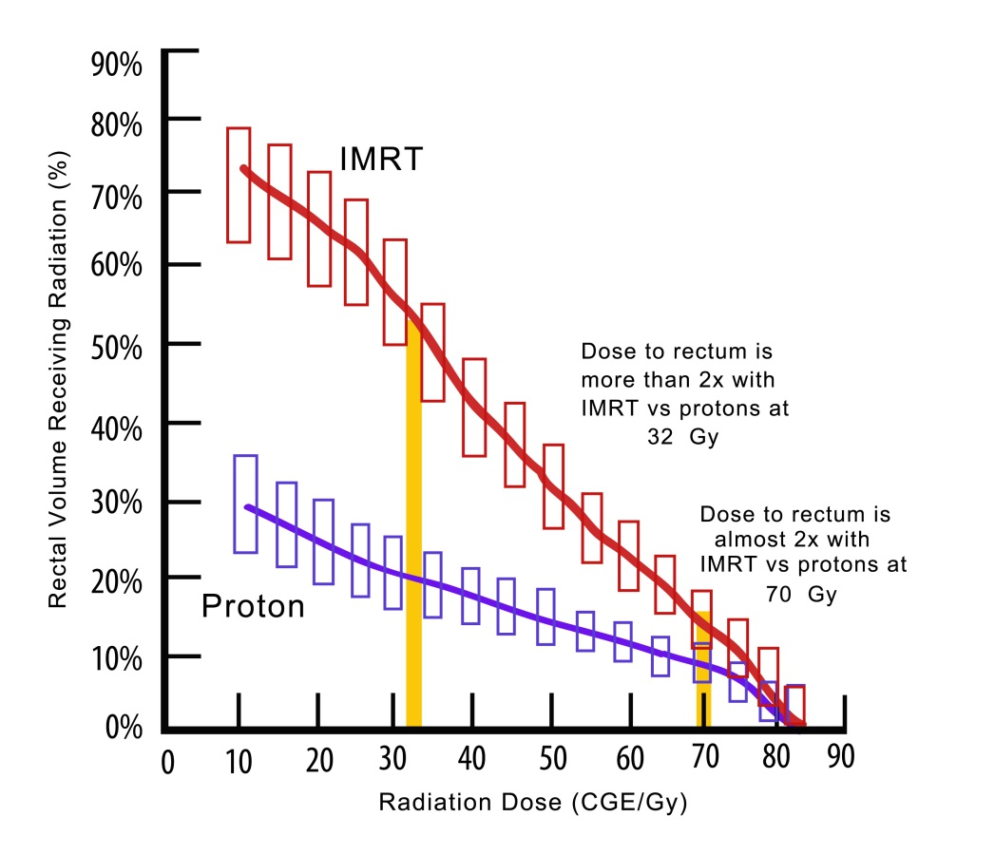
Proton Beam Therapy

Slide 14
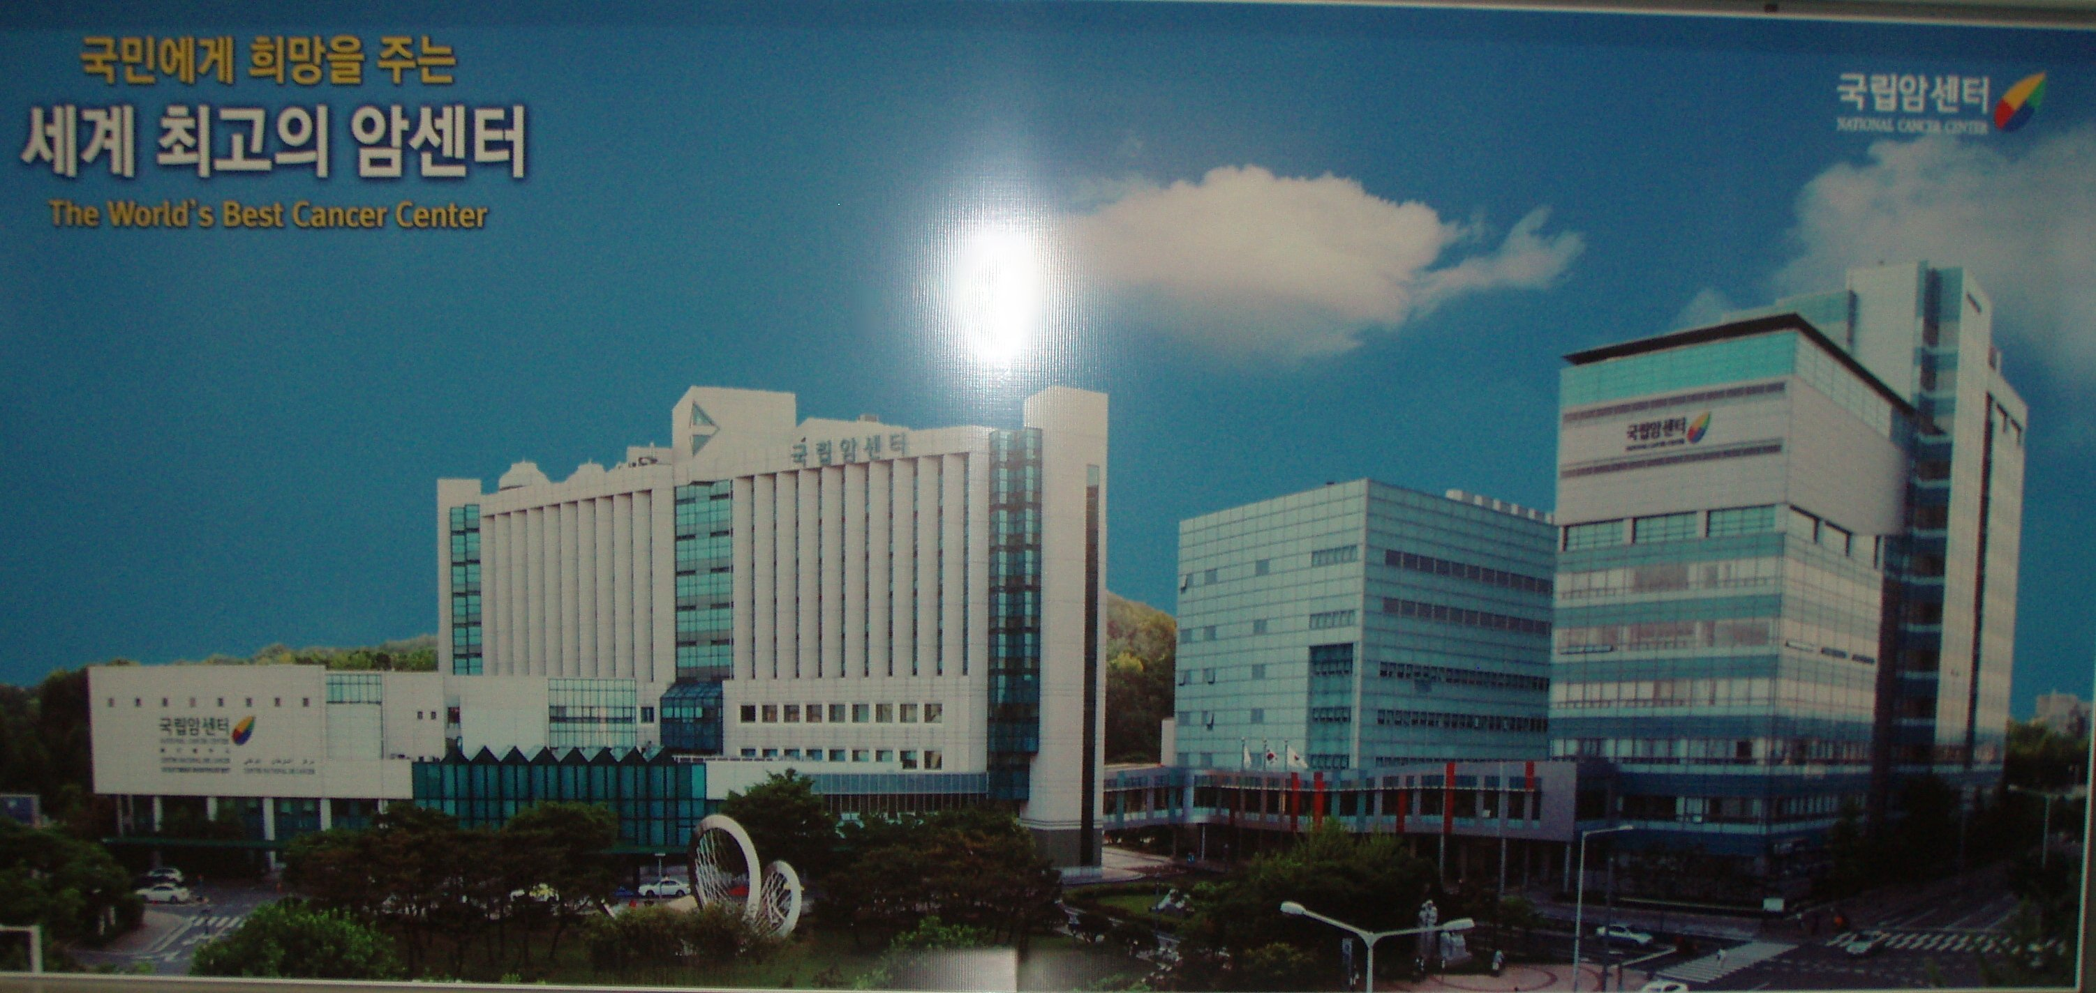
My Treatment in Korea
“World’s Best Cancer Treatment Centre”
Ultra Modern with all Latest Gear
All Specialists US Trained and Speak Perfect English
5 Star 2 Bedroom Apartment + Driver
Perfect Holiday Environment

Slide 15
Subsequent to Korea
Decided to Write a Book on PCa
Key Premise : Men Must Take Responsibility for Their Own Health Decisions
Don’t be Steamrolled by your Doctors
  Whilst in a state of Cancer Anxiety
Get all the Answers to your Questions
All Treatments Have Side Effects
Two Game-Changing Developments

Slide 16
Two Game-Changing
Developments
Multiparamagnetic MRI
  (mpMRI)
Focal Laser Ablation
  (FLA)

Slide 17
mpMRI
Been around for a while
New 3 Tesla strength units offer higher resolution
Also larger bore tunnels and open access machines give better patient access
Better Software

Slide 18
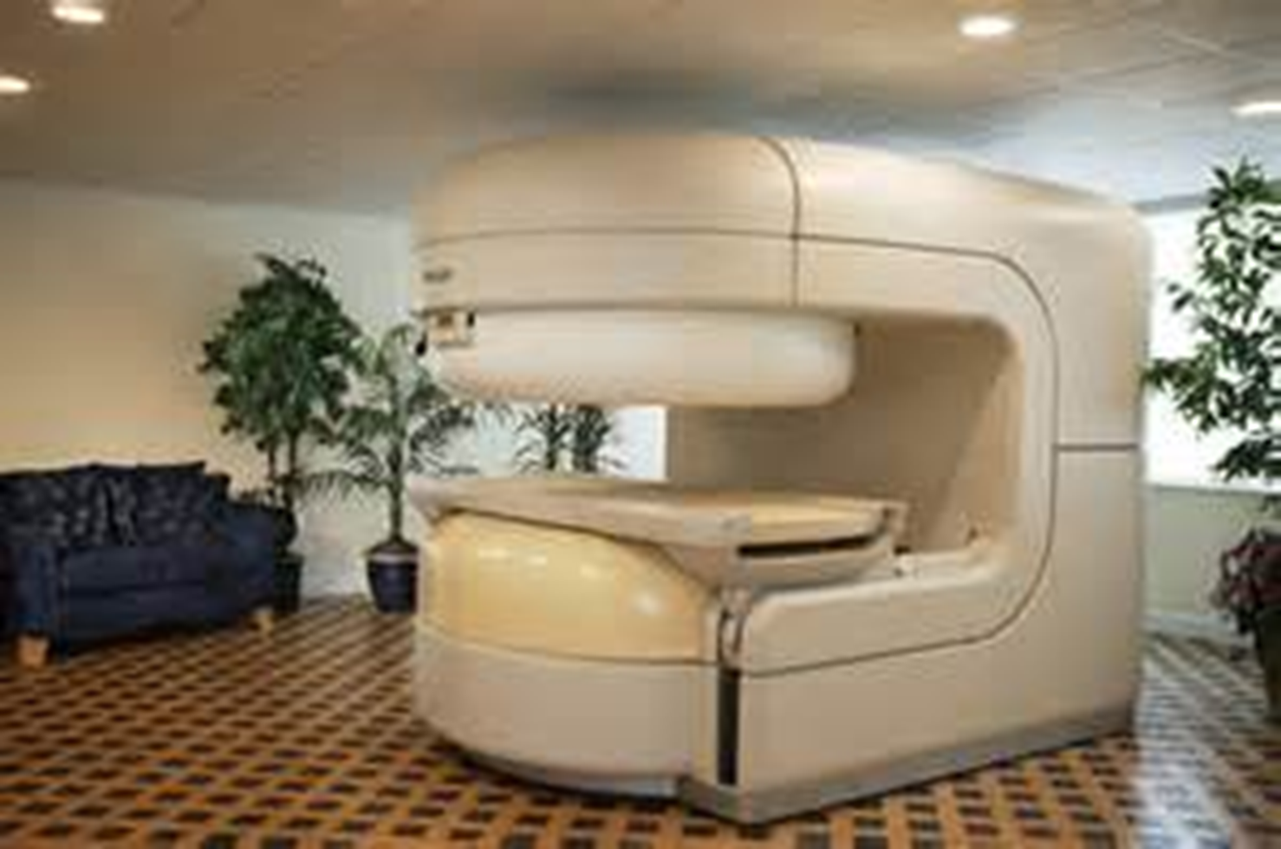

Slide 19
mpMRI Capabilities
T2-Weighted (T2W) imaging
Diffusion-weighted imaging (DW-MRI)
Dynamic contrast enhanced MRI (DCE-MRI)
MR spectroscopy
Endorectal Coil

Slide 20
T2-Weighted (T2W) imaging
The image contrast is weighted to match the density of various anatomical structures
Result: High Resolution Images of the Prostate and its Capsular Wall

Slide 21
Diffusion-Weighted Imaging
(DW-MRI)
It determines the Brownian motion of free water within tissue
The increased cellularity and lesser extracellular spaces found in cancer lesions are detected
The contrast between diseased and healthy tissue is displayed
The impedance of water molecule diffusion is also assessed and called apparent diffusion coefficient (ADC)

Slide 22
Dynamic Contrast Enhanced MRI
(DCE-MRI)
Angiogenisis
  Measures the increased vascularity of tumours
  Higher grade and large tumours have higher wash in and wash out of the injected contrasting agent than healthy tissue
  Not good for smaller tumours

Slide 23
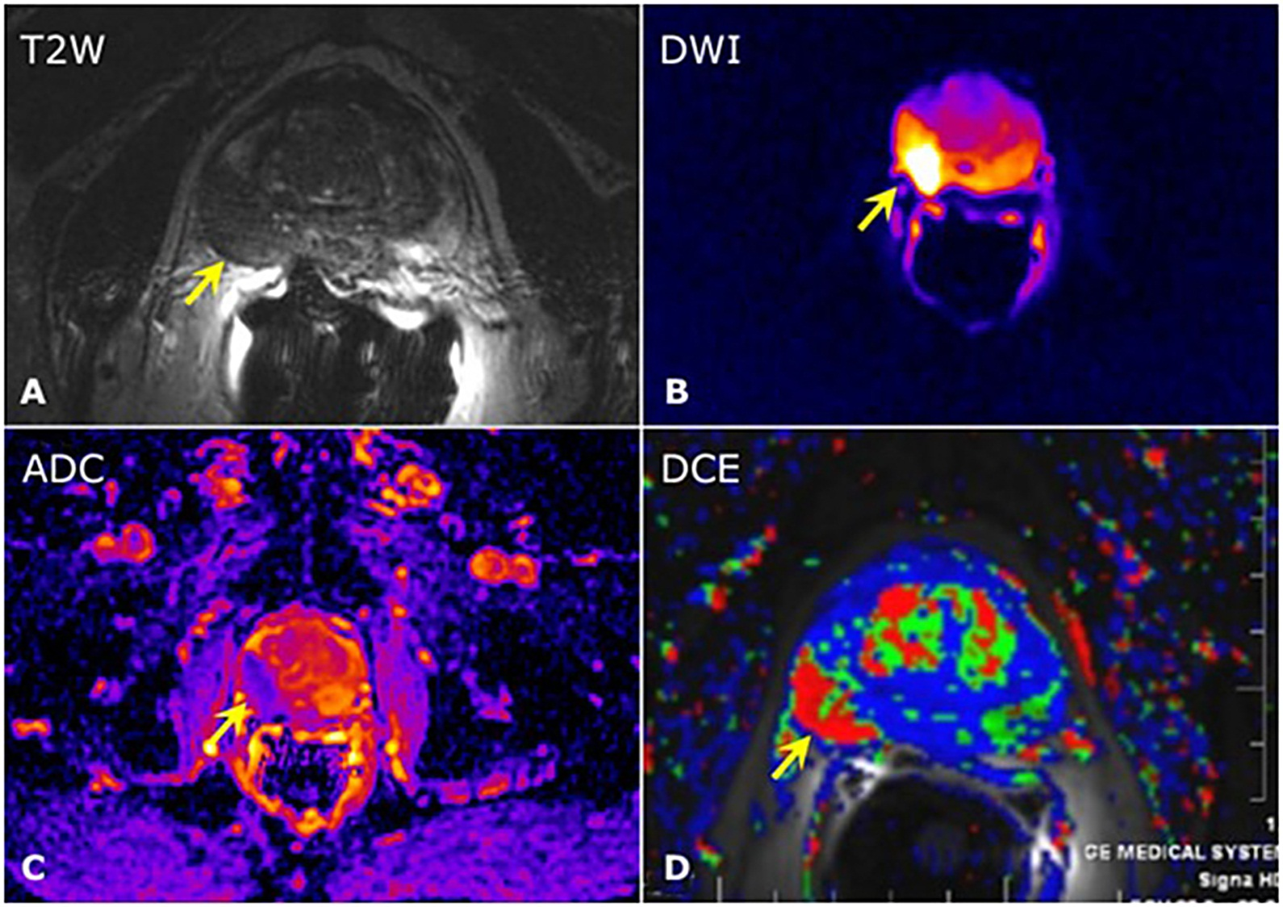
mpMRI Images of the Prostate

Slide 24
MRI Spectroscopy
Measures Choline, Citrate & Creatinine in Tissue
Healthy Prostate: Low Choline & High Citrate
Cancerous Prostate: High Choline & Low Citrate
mpMRI : Now often used PRIOR to biopsy

Slide 25
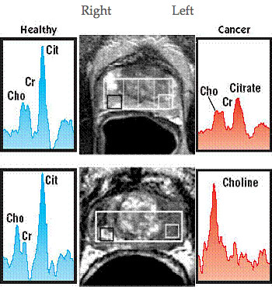

Slide 26
Focal Laser Ablation (FLA)
Now that the larger tumours can be seen, they can be selectively destroyed (ablated) by laser
Dr Dan Sperling in New York pioneered in situ FLA under MRI guidance
Now being done in Sydney
Generally No Side Effects

Slide 27


Slide 28
Doctors Comment on the Book
Dr L. (a leading Sydney Urologist) said:
  “Alan’s book is extensively researched and is most comprehensive”; “He has become an expert on the topic of prostate cancer and he fully understands what he has written”.
Dr R. (a retired Nephrologist and PCa Sufferer) said:
  “As a prostate cancer sufferer, I found the book to be excellent and right up to date”
:

Slide 29
Doctors Comment on the Book
Dr B, who works at the forefront of PSA diagnostics, said:
  “It is a well-researched and easily-understood book that should be “essential reading” for any newly diagnosed prostate cancer sufferer and their family”
Dr C, a radiation oncologist, said:
  Certainly, this book will help you and your loved ones, release the anxiety that you are experiencing and find hope for the future.”

Slide 30
Why You Should Consider this Book?
Its 285 pages are packed with essential information.
The best available reviews of the various treatments for prostate cancer are referenced
It’s written by a layman for laymen
Copies are available here for $25 (cash or credit card)

Slide 31
Alan Lawrenson Contacts
www.anabcofprostatecancer.com.au
www.facebook.com/AnABCofProstateCancer
anabcofprostatecancer@gmail.com
0414 483 373
305/2 Peninsula Drive Breakfast Point NSW 2137

Slide 32
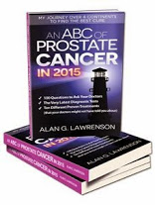
Questions?

